Slide 1
Getting Started with Vendor Pay Requests
Spitfire Project Management

Slide 2
Pay Requests
Requirements:
Commitment on a Project
Subcontracts
Purchase Orders
Pay Requests are generated from the Commitment Line Items:
Line Items Include:
Cost Code, Description, Contract Amount, Previously Paid, Current Units to Pay, Current Amount to Pay (Work and Material), Current % Complete, Net Pay, Retention

Slide 3
Commitment Basic Workflow
Commitment
Basic Workflow
Order Service and/or Materials for a Price (Committed Value)
Commitment can be printed to a “user-defined” template
Vendor/Subcontract sends invoice(s) for payment
Approved Pay Requests = Actuals which relieve the Committed Value
Commitment Change Orders can increase or decrease the Commitment
Compliance Items can be “assigned” to the Commitment and to the Commitment’s Vendor/Subcontract
Out-of-Compliance Compliance Types can block Pay Request approvals
Commitment Change Order
Pay Requests
Accounting
Accounts Payable
Note for Dynamics SL
MS Dynamics SL
Contract Management
Subcontract Payment Review and Approval
In Dynamics SL, the Vendor Pay Request goes through Contract Management to get to Accounts Payable
MS Dynamics SL
Accounts Payable

Slide 4
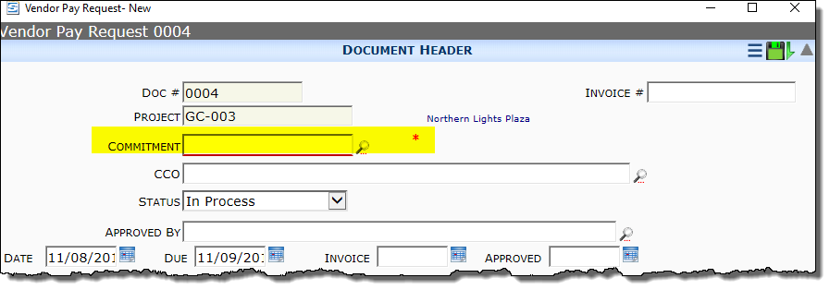
Creating a Pay Request
Click the Create New icon on the Pay Request document list
Select the Commitment

Slide 5
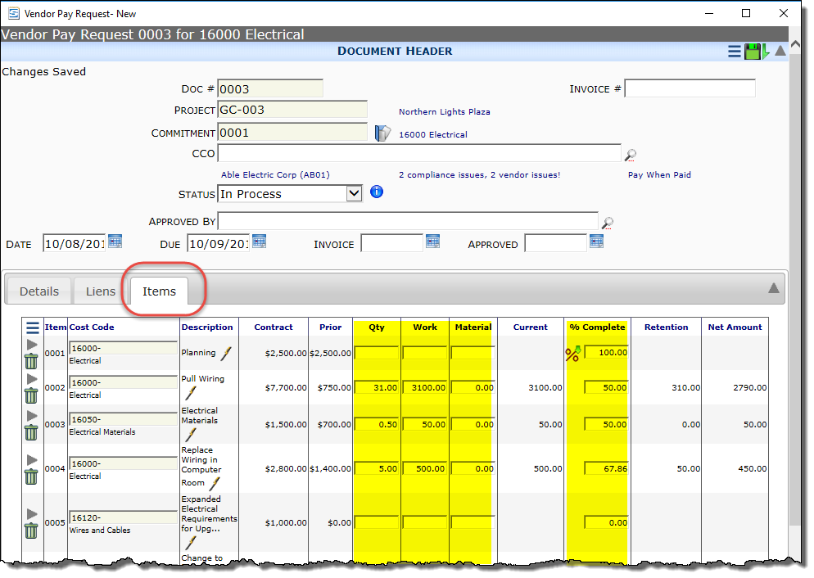
Pay Request Line Items
Once you enter the Commitment Number
Line Items are automatically added from the Commitment.
Add the following information in the Document Header
Invoice #
Invoice Date
On the Line Items enter 1 of the following the items to be paid
Qty
Work and/or Material
% Complete
Click the Copy % icon to copy to additional lines below
Notice that Retention and Net Amount are automatically calculated
Save

Slide 6
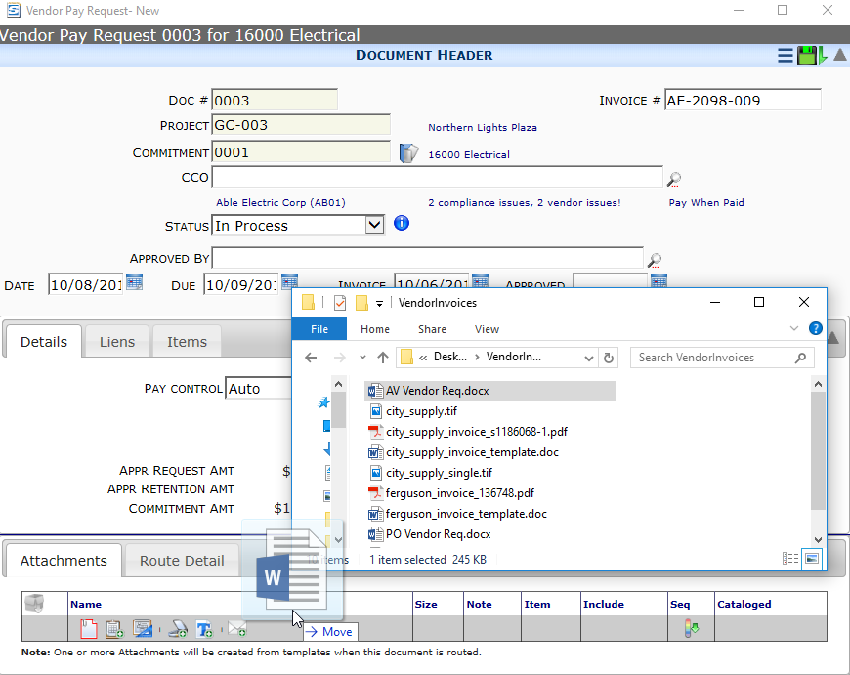
Pay Request Attachment
Add the Vendor’s Invoice to the Attachment tab
Drag and Drop your files
Use Add Files dialog
Route document to interested parties for approval

Slide 7
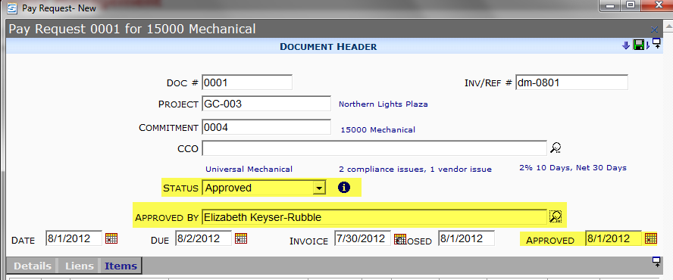
Pay Request Approval
Enter the following:
Status = Approved
Approved by
Approved Date (it defaults to today but you can enter a previous date)
Save

Slide 8
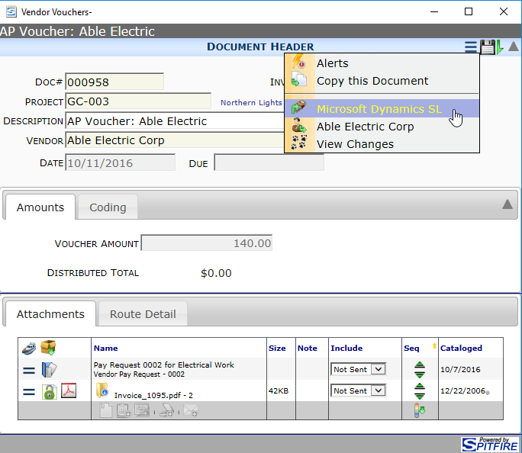
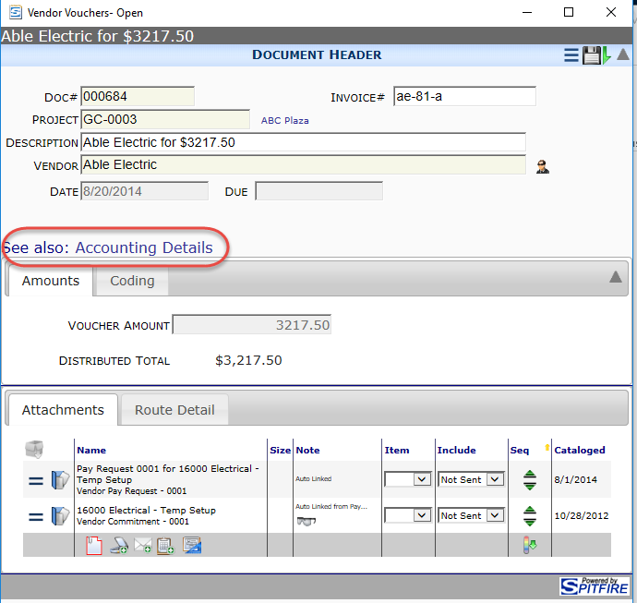
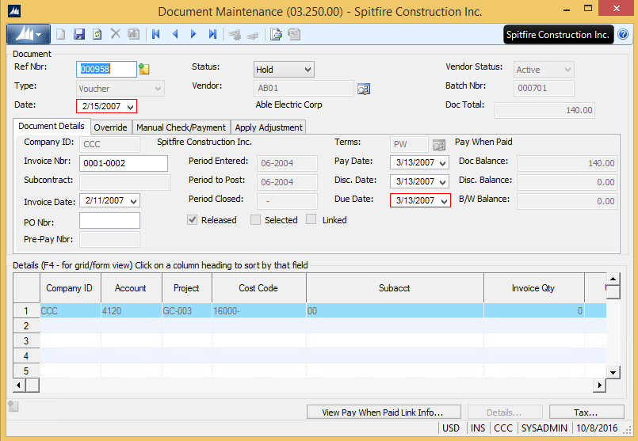
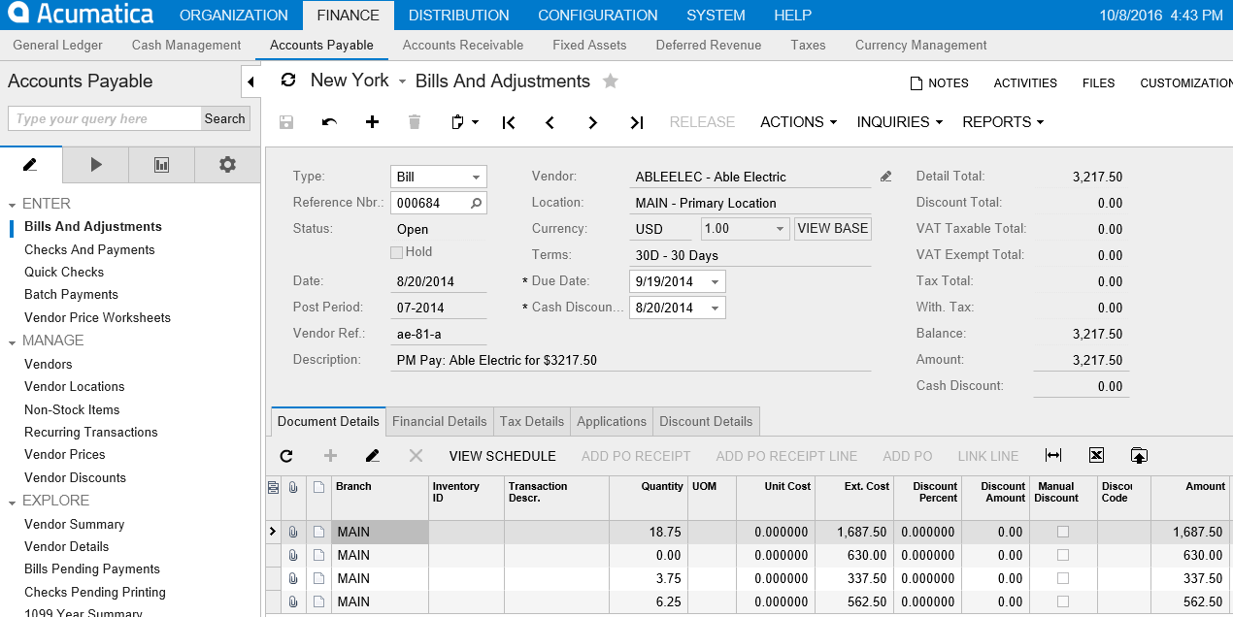
Connection to Accounts Payable
Spitfire’s Vendor Voucher links to the Accounting Voucher/Bill and Adjustments
Dynamics SL
Acumatica
Dynamics SL users: See next slide for Posting to AP from Contract Management.

Slide 9
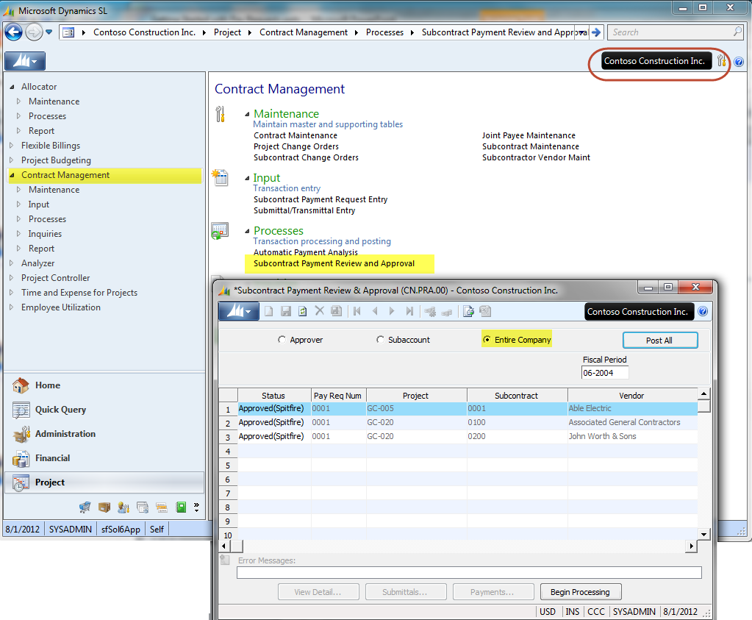
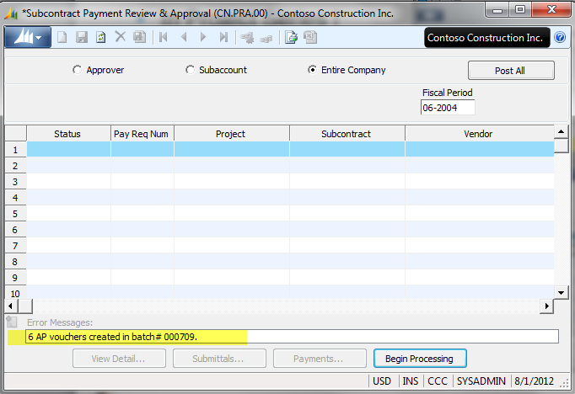
In Dynamics SL, Post Pay Request
In Project Series | Contract Management, select Subcontract Payment Review and Approval.
Be sure you are in the correct Company
Select Entire Company
Select Post All – or select Individual Pay Request to Post
Click Begin Processing
After Processing, check the text box for messages

